Slide 1
Step Size Selection in Frank-Wolfe Method
Paper Review and Replication
Higher School of Economics

Slide 2
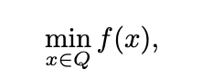
Motivation and Problem: Compare different step size selection methods for FW method
This project aims to explore, evaluate and conduct numerical comparison of the efficiency of step selection strategies in the Frank-Wolfe method on different problems with different dimensions and condition numbers. It can solve problems of the form
We consider four strategies for step size selection and compare corresponding Frank-Wolfe method performance on both real and synthetic data with different properties and constraints on the solution.
As other gradient-based methods, the FW algorithm depends on a step size parameter gamma. The following step size selection approaches were considered:

Slide 3
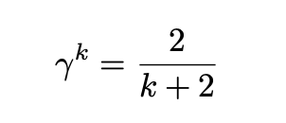
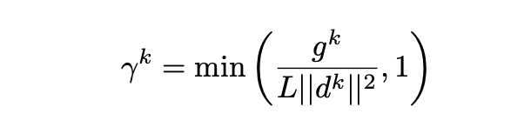
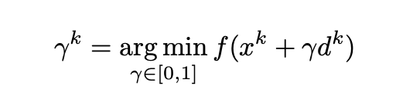
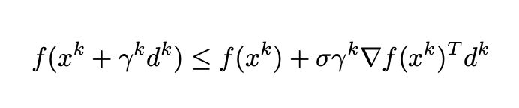
Proposed methods for compare
Predefined Decreased (Trivial)
Demyanov-Rubinov
Exact Line-search
Armijo method

Slide 4
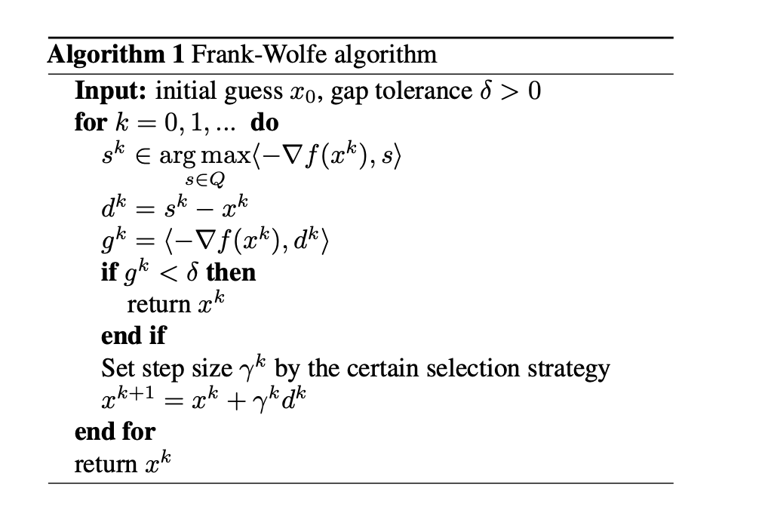
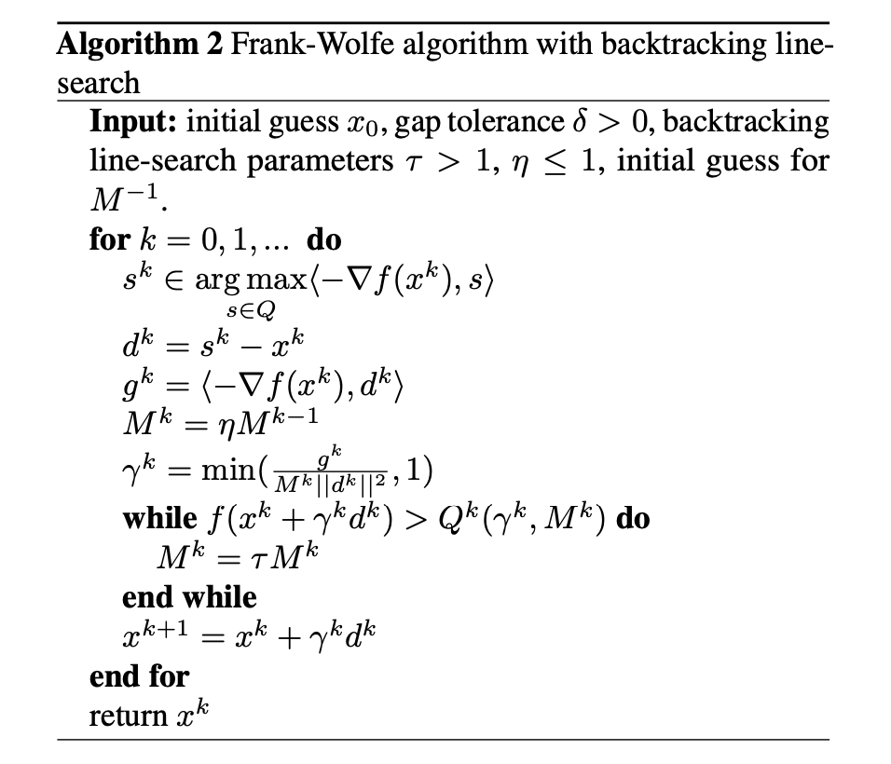
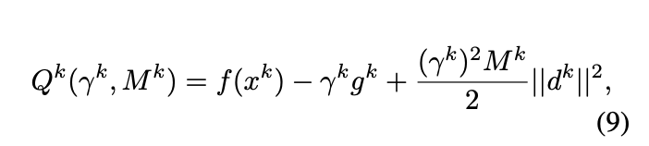
Frank-Wolfe Algorithm

Slide 5
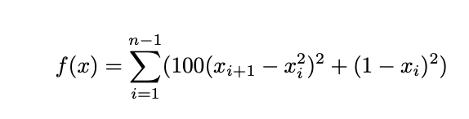
Experiments: Datasets
UCI Mushrooms (binary classification dataset, contains descriptions of mushrooms (poisonous/edible), 8124 objects, 22 features)
UCI Gisette (binary classification dataset, contains engineered features of handwritten digits, 13500 objects, 5000 features)
UCI Covertype (binary classification dataset, contains cartographic variables, 581012 objects, 54 features)
Synthetic normal (binary classification dataset, generated from scipy package, 5000 objects, 50 features)
Synthetic ill-conditioned (binary classification dataset, generated from scipy package, 5000 objects, 1024 features)
Synthetic high-dimensional (binary classification dataset, ill-conditioned, 5000 objects, 50 features)
Rosenbrock function

Slide 6
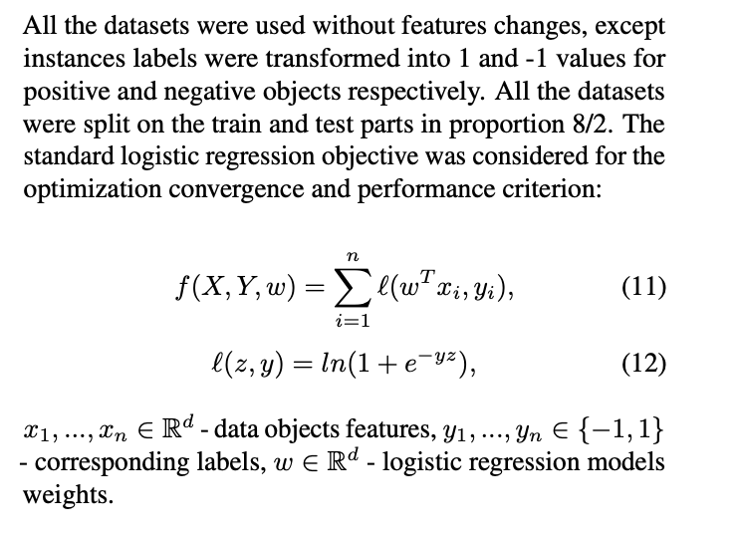
Experiments: Setup and constraints
Constraints
Setup
For constraint sets on the desired solution we considered l1 and l2 balls centered at 0, of radiuses R = 10, 100, 500

Slide 7
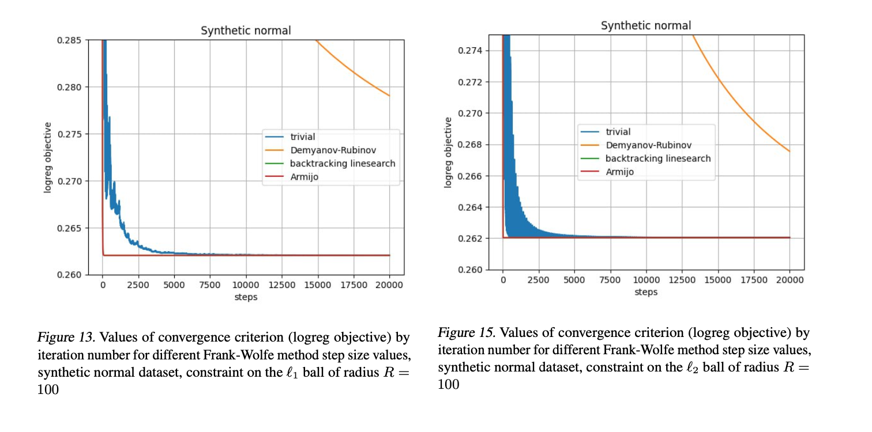
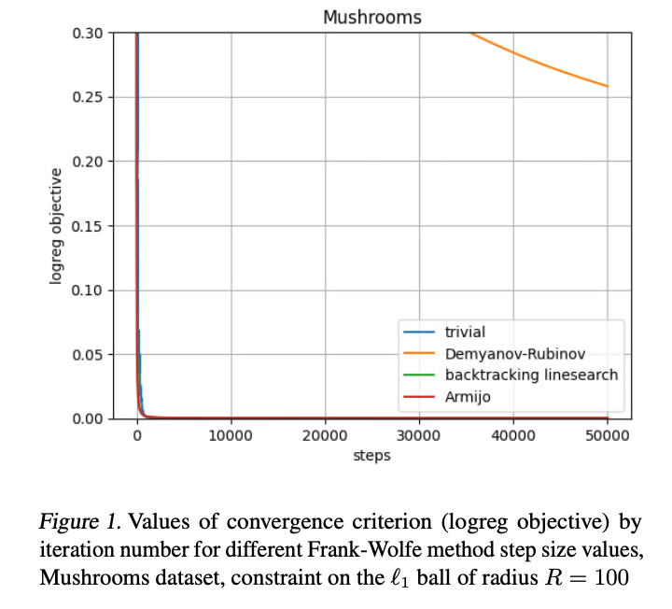
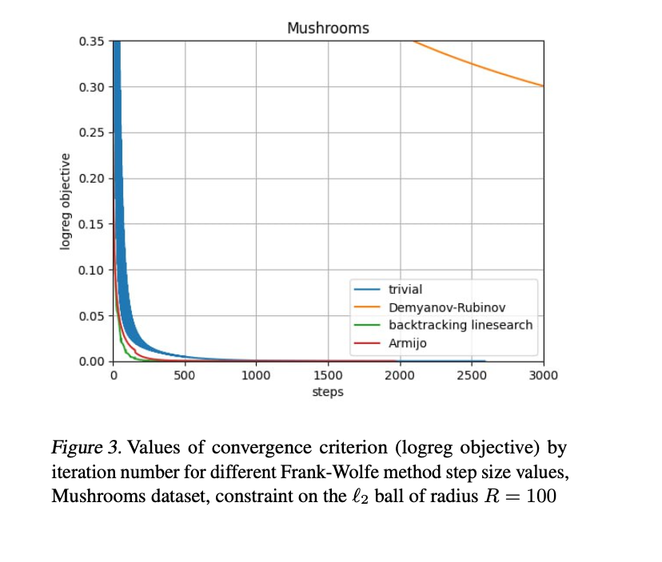
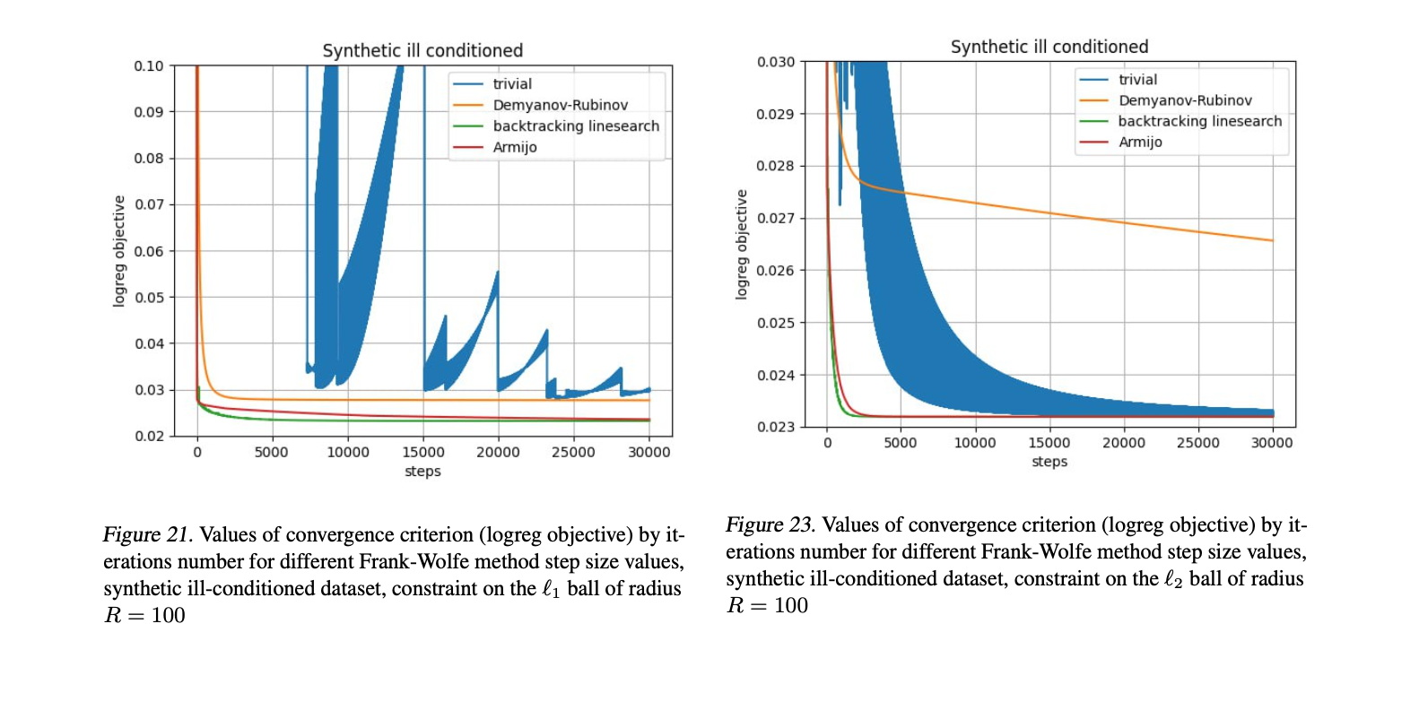
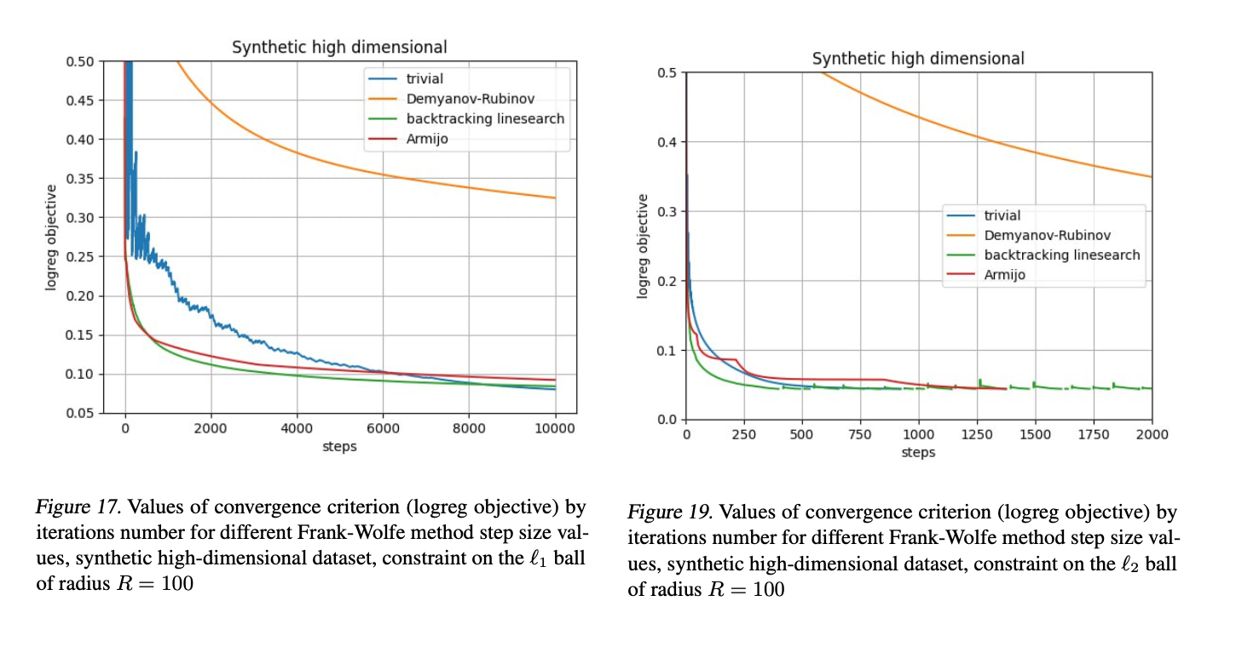
Mushrooms + synthetic results

Slide 8
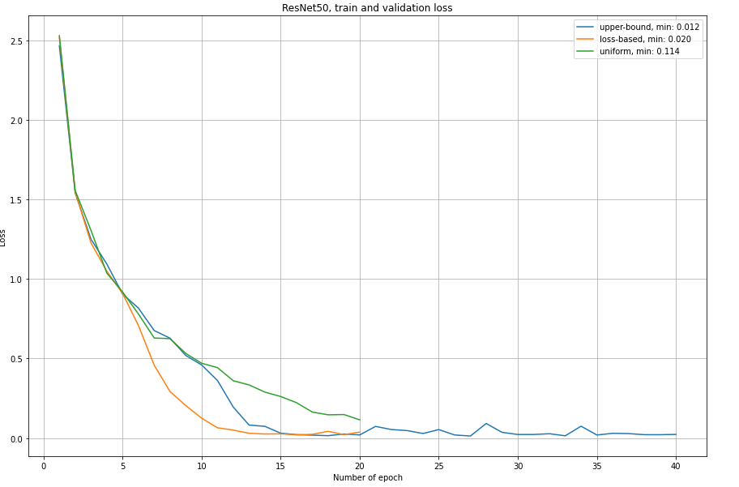
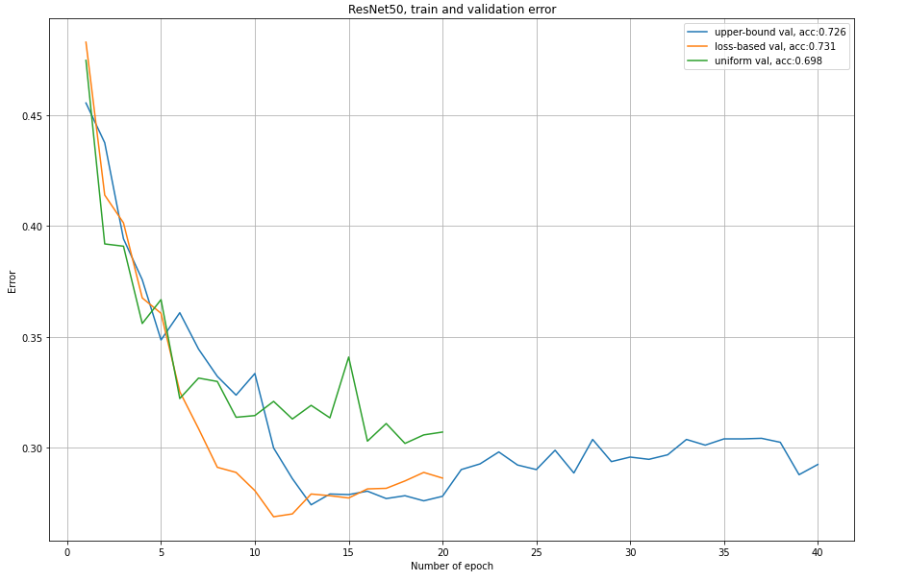

Gisette + Covtype
Train Loss by 20-40 epochs of ImageNet + ResNet 50
Upper-bound Minimum: 0.012
Uniformly Minimum: 0.114
Loss-based Minimum: 0.020
Test Error by 20-40 epochs of ImageNet + ResNet 50
Upper-bound Minimum: 0.274
Uniformly Minimum: 0.302
Loss-based Minimum: 0.269
MIT 67

Slide 9
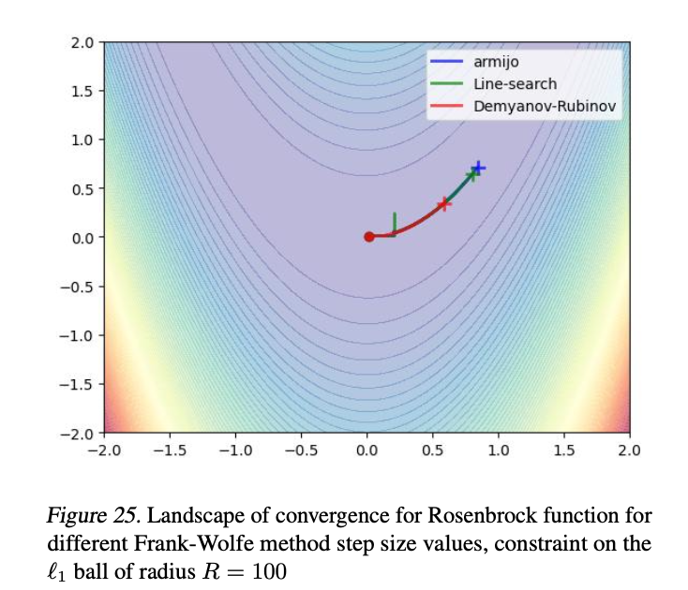
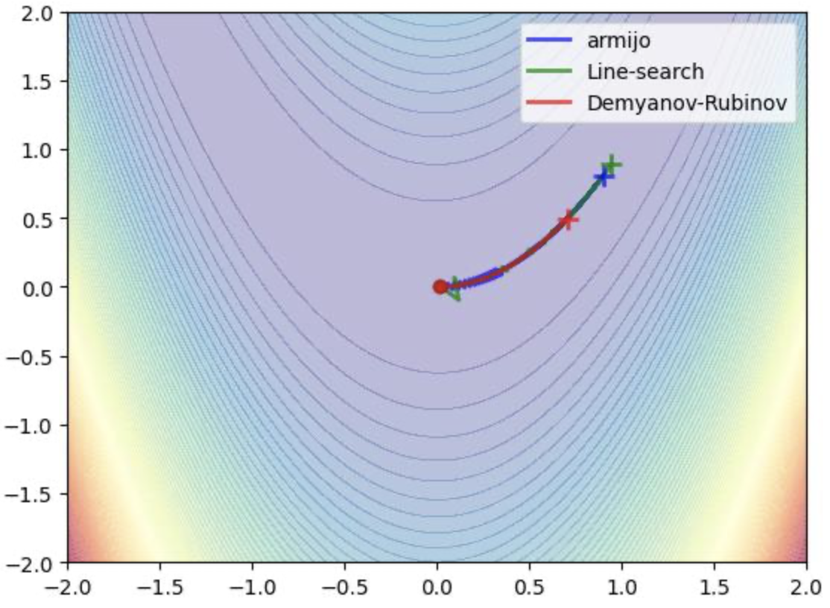
Rosenbrock Results
Figure 24. Landscape of convergence for Rosenbrock function for different Frank-Wolfe method step size values, constraint on the l2 ball of radius R = 100

Slide 10
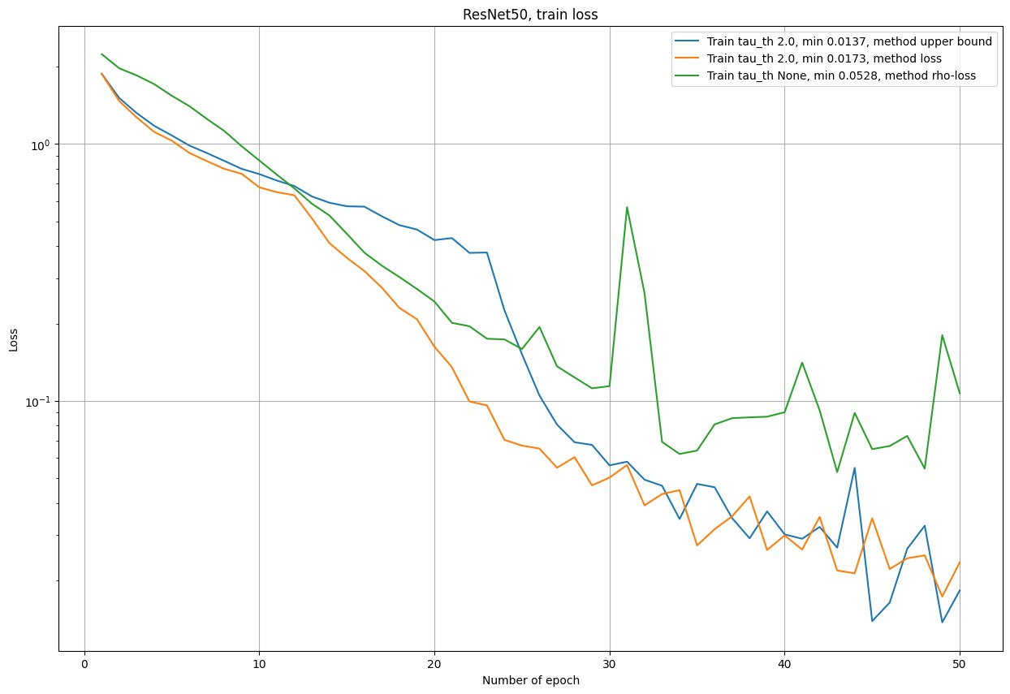
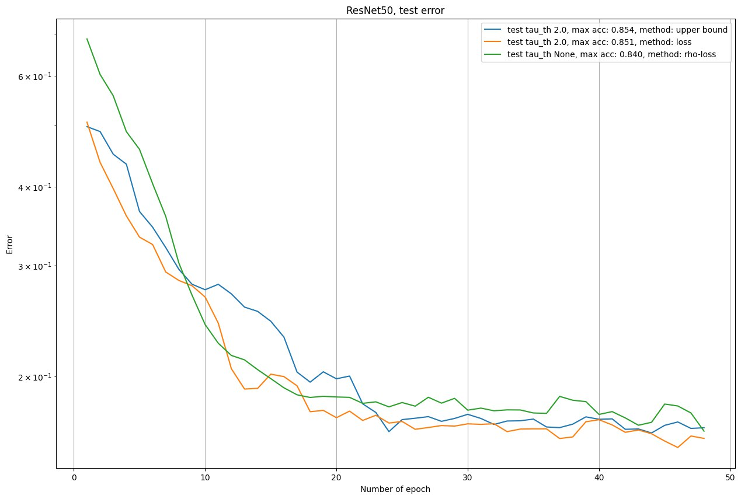
Comparison: loss-based vs RHO-LOSS vs upper-bound
Train Loss by 50 epochs of ResNet 50
Upper-bound Minimum: 0.014
RHO-LOSS Minimum: 0.053
Loss-based Minimum: 0.017
Test Error by 50 epochs of ResNet 50
Upper-bound Minimum: 0.146
RHO-LOSS Minimum: 0.160
Loss-based Minimum: 0.149
CIFAR 10

Slide 11
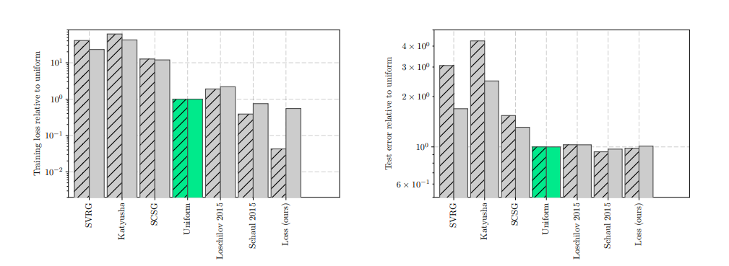
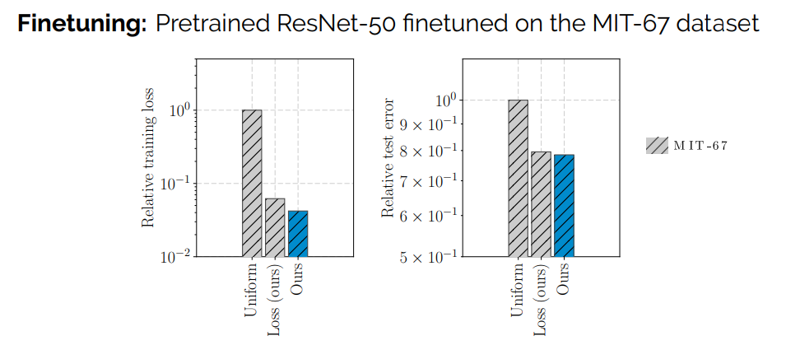
Conclusion
Method Advantages
For fine-tuning earlier variance reduction leads to faster convergence
Improvement from 3× to 10× compared to training loss with uniform sampling
For image classification our loss-based sampling outperforms existing loss based methods
Our method outperform RHO-LOSS
Image Classification: ResNet-50 on the CIFAR-10 dataset
Our GitHub: github.com/MarioAuditore/frank_wolfe_step_selection

Slide 12




Our Team
Ignat Romanov Core algorithm development, Datasets preparation, Experiments
Petr Sychev Theory Research, Armijo method, Preso
Boris Miheev Project Description, Literature review, Experiments
Elfat Sabitov Core algorithm development, Experiments, GitHub repository

